Slide 1

Modern Database Management
Thirteenth Edition, Global Edition
Chapter 3
The Enhanced E-R Model
Copyright © 2020 Pearson Education Ltd. All Rights Reserved
Notes:
If this PowerPoint presentation contains mathematical equations, you may need to check that your computer has the following installed:
1) MathType Plugin
2) Math Player (free versions available)
3) NVDA Reader (free versions available)

Slide 2
Learning Objectives
3.1 Define terms
3.2 Understand use of supertype/subtype relationships
3.3 Use specialization and generalization techniques
3.4 Specify completeness and disjointness constraints
3.5 Develop supertype/subtype hierarchies for business situations
3.6 Develop entity clusters
3.7 Explain universal (packaged) data model
3.8 Describe special features of data modeling project using packaged data model

Slide 3
Supertypes and Subtypes
Enhanced E-R (E E R) model: extends original E-R model with new modeling constructs
Subtype: A subgrouping of the entities in an entity type that has attributes distinct from those in other subgroupings
Supertype: A generic entity type that has a relationship with one or more subtypes
Attribute Inheritance:
Subtype entities inherit values of all attributes and relationships of the supertype
An instance of a subtype is also an instance of the supertype
Notes:
The ideas of supertypes, subtypes, and inheritance, which are central to the EER model, are also key concepts in object-oriented software design and programming. If you ever use an object-oriented programming language like Java or C++, you will encounter the concept of classes, which are similar to “types”. These classes are arranged in hierarchies, which enable inheritance.
The difference between object-oriented programming and EER supertypes/subtypes is that in object-oriented programming there is also the concept of behavior. Objects not only have attributes (which can be inherited), but they also have “methods” which implement active behaviors.

Slide 4
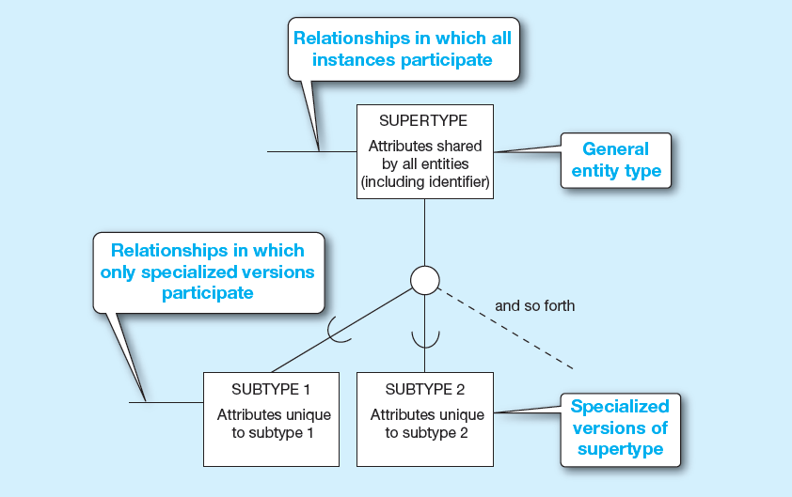
Figure 3-1 Basic Notation for Supertype/Subtype Notation (1 of 2)
a) E E R notation
Notes:
This is only one possible notation for EER. In other figures we will see Microsoft Visio notation, which is similar but not identical.

Slide 5
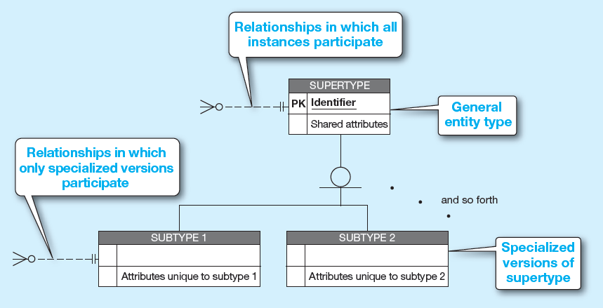
Figure 3-1 Basic Notation for Supertype/Subtype Notation (2 of 2)
b) Microsoft Visio Notation

Slide 6
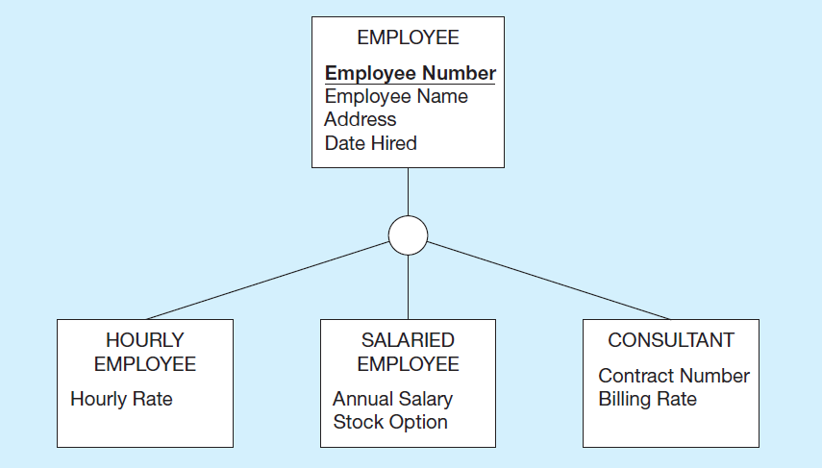
Figure 3-2 Employee Supertype with Three Subtypes
All employee subtypes will have employee number, name, address, and date hired
Each employee subtype will also have its own attributes
Notes:
It makes sense to model supertypes and subtypes if certain attributes or relationships apply only to a subset of the total entity type whereas others are shared across the entire entity type. In this case, all employees have names, addresses, and hire dates. But only hourly employees have hourly rates, only salaried employees have salaries and stock options, and only consultants have contract numbers and billing rates. If we simply had an employee entity, then these special-purpose attributes would be irrelevant for many of the employees.

Slide 7
Relationships and Subtypes
Relationships at the supertype level indicate that all subtypes will participate in the relationship
The instances of a subtype may participate in a relationship unique to that subtype. In this situation, the relationship is shown at the subtype level

Slide 8
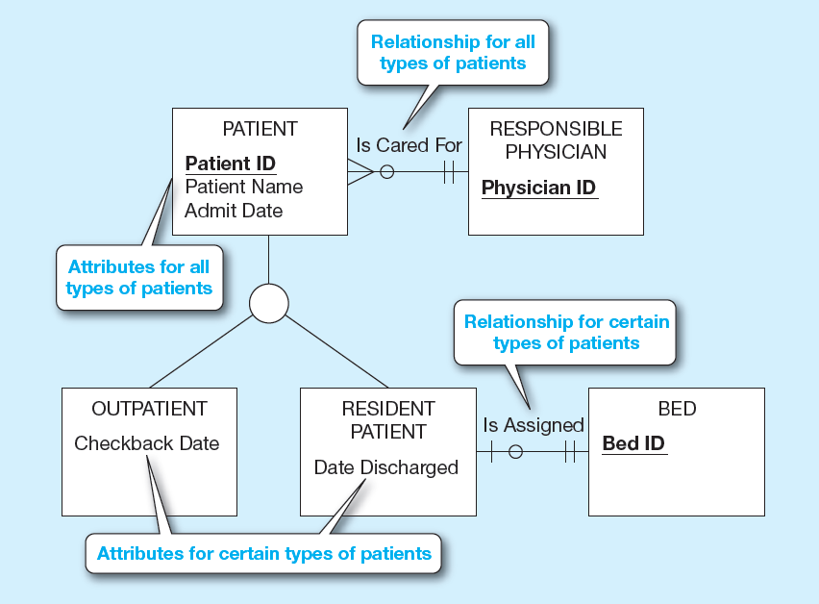
Figure 3-3 Supertype/Subtype Relationships in a Hospital
Notes:
This is a good example of the distinction between shared attributes/relationships and specialized attributes/relationships. So, it makes sense to break patients into two subtypes.

Slide 9
Generalization and Specialization
Generalization: The process of defining a more general entity type from a set of more specialized entity types. BOTTOM-UP
Specialization: The process of defining one or more subtypes of the supertype and forming supertype/subtype relationships. TOP-DOWN

Slide 10
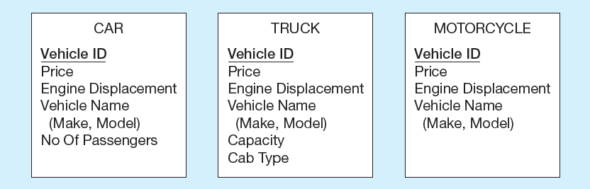
Figure 3-4 Example of Generalization (1 of 2)
a) Three entity types: CAR, TRUCK, and MOTORCYCLE
All these types of vehicles have common attributes
Notes:
Sometimes during the conceptual modeling process, we begin to recognize common themes among several entity types. For instance, they may all share many of the same attributes, such as in this example. Here, cars, trucks, and motorcycles all have prices, engine displacements, and vehicle makes and models.

Slide 11
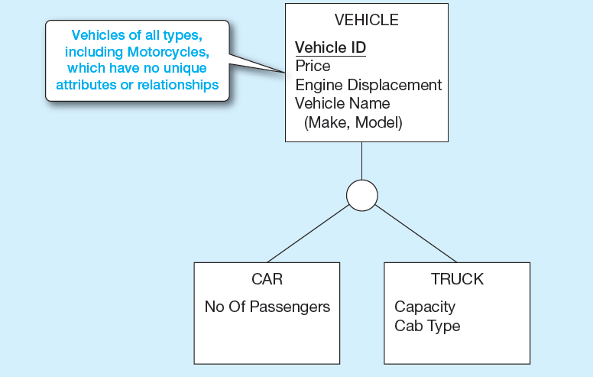
Figure 3-4 Example of Generalization (2 of 2)
b) Generalization to VEHICLE supertype
We put the shared attributes in a supertype. Note: no subtype for motorcycle, since it has no unique attributes
Notes:
So, when this happens, we can create a supertype and place the shared attributes in the supertype entity. This process is called “generalization”.
The specialized attributes go into subtype entities. In the case of the motorcycle, there is no unique attribute, so there is no need for a specific “motorcycle” entity.
Actually, it may be useful to have an indication that a vehicle is in fact a motorcycle. Later we will discuss the concept of a “subtype discriminator”, which is a special attribute at the supertype level that identifies the specific subtype.

Slide 12

Figure 3-5 Example of Specialization (1 of 2)
a) Entity type PART
Note: Routing Number only applies if part is manufactured in house.
Supplier only applies if part is purchased from a supplier.
Notes:
Sometimes during conceptual modeling we discover that certain attributes (or relationships) apply only to a subset of the entities in a given entity type. In this example, we have a manufacturing firm that may manufacture some of its own parts and purchase others. If the part is manufactured by the firm itself, it has a routing number; but if purchased, it does not. If purchased, it comes from a supplier; but if manufactured, it does not.
Note that the representation of supplier as a composite multivalued attribute in this diagram.

Slide 13
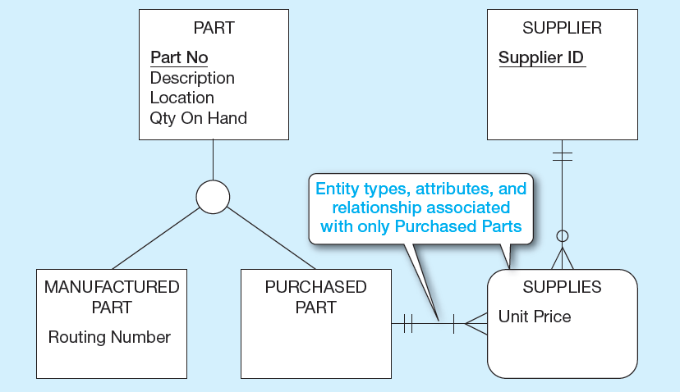
Figure 3-5 Example of Specialization (2 of 2)
b) Specialization to MANUFACTURED PART and PURCHASED PART
Multivalued composite attribute replaced by associative entity relationship to another entity
Notes:
When we find a situation like this, it makes sense to do “specialization”. In this case, we created two subtypes of Part, one for manufactured parts and one for purchased part. All parts have part numbers, descriptions, locations, and quantity. But only manufactured parts have routing numbers, and only purchased parts have suppliers.
Note that unlike the previous slide, the concept of supplier is now represented as a separate entity, and an associative entity represents a M:N relationship between purchased part and supplier, with unit price being an attribute of the associative entity.
This provides information that was not explicit in the previous figure. A multivalued attribute does not explicitly describe a M:N relationship. It could also convey a 1:N relationship. But when you represent the supplier as a separate entity, you can explicitly show the cardinality of relationship.
For an example of a multivalued attribute that implies a 1:N relationship, refer to figure 2.19 from Chapter 2. Here we have time stamps of price history changes. For a given product, there may be many price history items, but each price history item belongs to only one product. That’s different from what we have here with parts and suppliers, where a part can have many suppliers and a supplier could supply many parts.

Slide 14
Constraints in Supertype/Subtype Relationships
Completeness Constraints: Whether an instance of a supertype must also be a member of at least one subtype
Total Specialization Rule: Yes (double line)
Partial Specialization Rule: No (single line)
Notes:
There are two types of constraints in supertype/subtype relationships. One is called a completeness constraint, and indicates whether there must be an explicit subtype for each possible instance of the supertype. The other is called a disjointness constraint, which indicates whether a particular instance of a supertype could also be more than one of the subtypes.

Slide 15
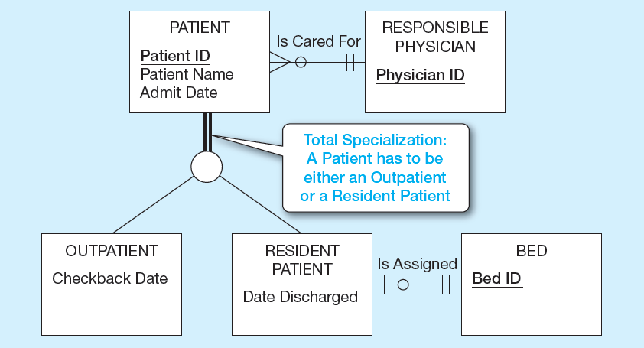
Figure 3-6 Examples of Completeness Constraints (1 of 2)
a) Total specialization rule
Notes:
In this case, a patient MUST either be an outpatient or a resident patient. There is no other possibility. This particular completeness constraint is called total specialization, and is represented by double lines coming down from the supertype entity type.

Slide 16
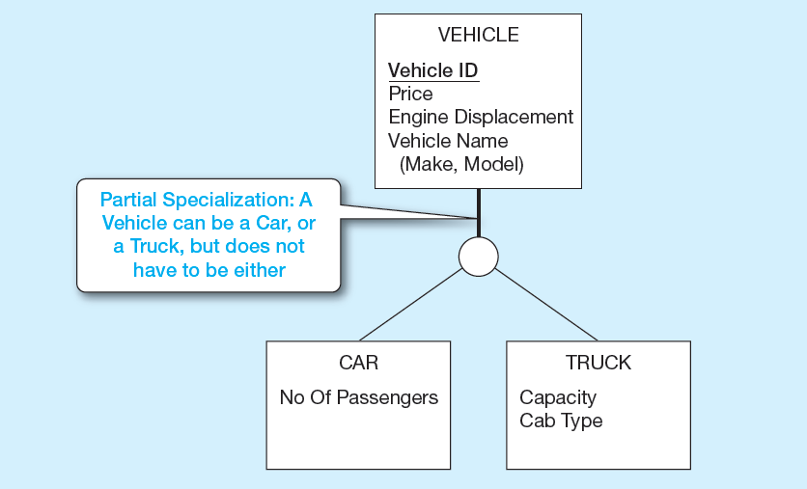
Figure 3-6 Examples of Completeness Constraints (2 of 2)
b) Partial specialization rule
Notes:
We already saw this example from earlier. This is partial specialization, because some vehicles are motorcycles, which is not explicitly represented as a subtype entity.
Question: Going back to figure 3-5, do you think the division of PART into manufactured vs. purchased parts implies total specialization or partial specialization ?
Answer: Probably total specialization. Either a part is manufactured in-house or purchased from an external supplier. There is probably no other option.

Slide 17
Constraints in Supertype/Subtype Relationships (1 of 2)
Disjointness Constraints: Whether an instance of a supertype may simultaneously be a member of two (or more) subtypes
Disjoint Rule: An instance of the supertype can be only ONE of the subtypes
Overlap Rule: An instance of the supertype could be more than one of the subtypes
Notes:
There are two types of constraints in supertype/subtype relationships. One is called a completeness constraint, and indicates whether there must be an explicit subtype for each possible instance of the supertype. The other is called a disjointness constraint, which indicates whether a particular instance of a supertype could also be more than one of the subtypes.
So, we can have four possibilities: total specialization with disjoint, total specialization with overlap, partial specialization with disjoint, or partial specialization with overlap.

Slide 18
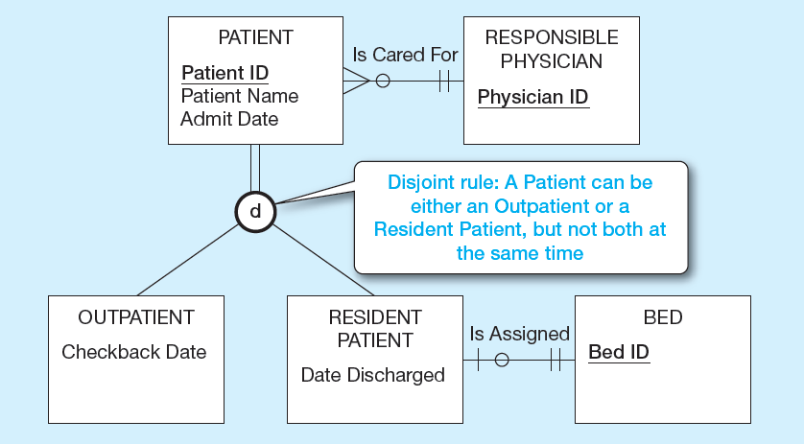
Figure 3-7 Examples of Disjointness Constraints (1 of 2)
a) Disjoint rule
Notes:
Here we see a disjoint (not overlap) rule regarding patients. A patient can’t be both a resident and an outpatient, at least not at the same time. Of course it’s possible for a patient to be a resident for a period of time and then change to an outpatient (or vice versa), but the patient cannot be both simultaneously.

Slide 19
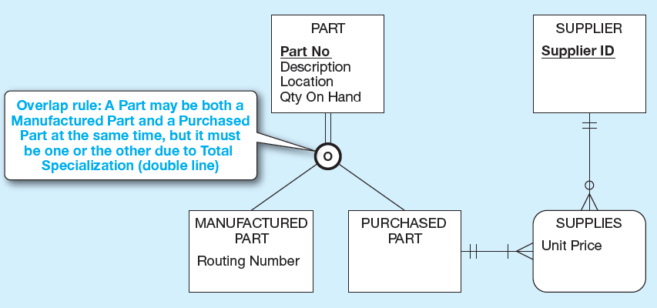
Figure 3-7 Examples of Disjointness Constraints (2 of 2)
b) Overlap rule
Notes:
Here is an overlap rule. Some kinds of parts could be manufactured in-house and also purchased from external suppliers. Note the total specialization rule, which we discussed earlier.

Slide 20
☑ Check Point
In this class, we have learnt two constraints and the corresponding rules for them.
Completeness Constraints:
Total Participation Rule (denoted by double lines)
Partial Participation Rule (denoted by single line)
Disjointness Constraints:
Disjoint Rule (denoted by letter «d»)
Overlap Rule (denoted by letter «o»)
Suppose that you are going to model the supertype entity Student with the subtype entities DoubleMajor and Minor. Assume that a student cannot be both a doble major and a minor student at the same time. How would you model the relationship between the supertype and the subtype entities?
A) Total & Overlap B) Total & Disjoint C) Partial & Overlap D) Partial & Disjoint
<--- ANSWER --->
D) Partial & Disjoint

Slide 21
Constraints in Supertype/Subtype Relationships (2 of 2)
Subtype Discriminator: An attribute of the supertype whose values determine the target subtype(s)
Disjoint – a simple attribute with alternative values to indicate the possible subtypes
Overlapping – a composite attribute whose subparts pertain to different subtypes. Each subpart contains a Boolean value to indicate whether or not the instance belongs to the associated subtype

Slide 22
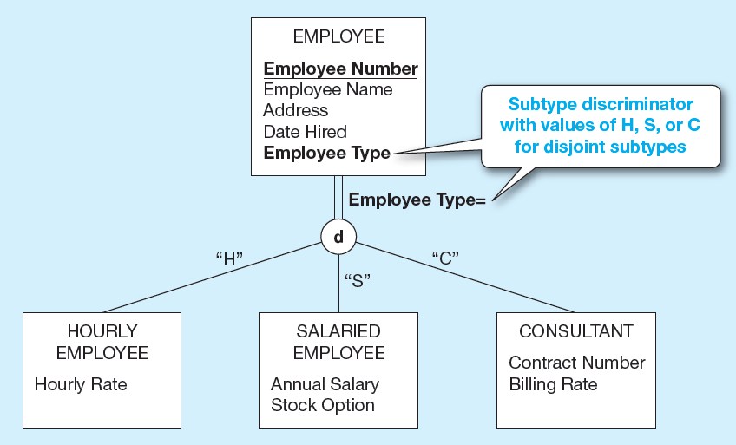
Figure 3-8 Introducing a Subtype Discriminator (Disjoint Rule)
Notes:
Here, for the disjoint rule we have Employee Type as the subtype discriminator, and it can have three possible values, one for each subtype.
Going back to figure 3-7, what would be a possible subtype discriminator, and what would its values be?

Slide 23
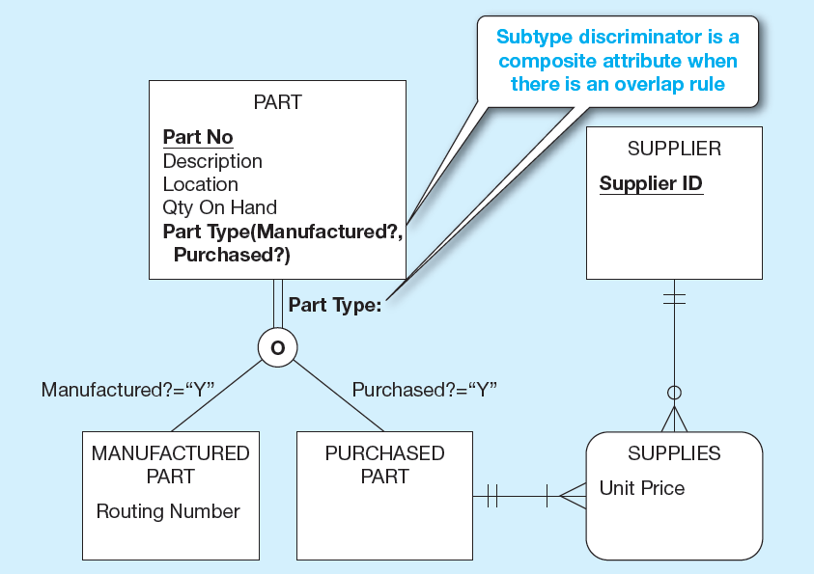
Figure 3-9 Subtype Discriminator (Overlap Rule)
Notes:
Note the requirement for a composite subtype discriminator here. So, there are three possible scenarios:
Manufactured = “Y” and Purchased = “Y”
Manufactured = “Y” and Purchased = “N”
Manufactured = “N” and Purchased = “N”
Note that it is impossible for this scenario to occur: Manufactured = “N” and Purchased = “N”. Why is this not possible?
Answer: Because of the total specialization rule. At least one of these have to be “Y”.

Slide 24
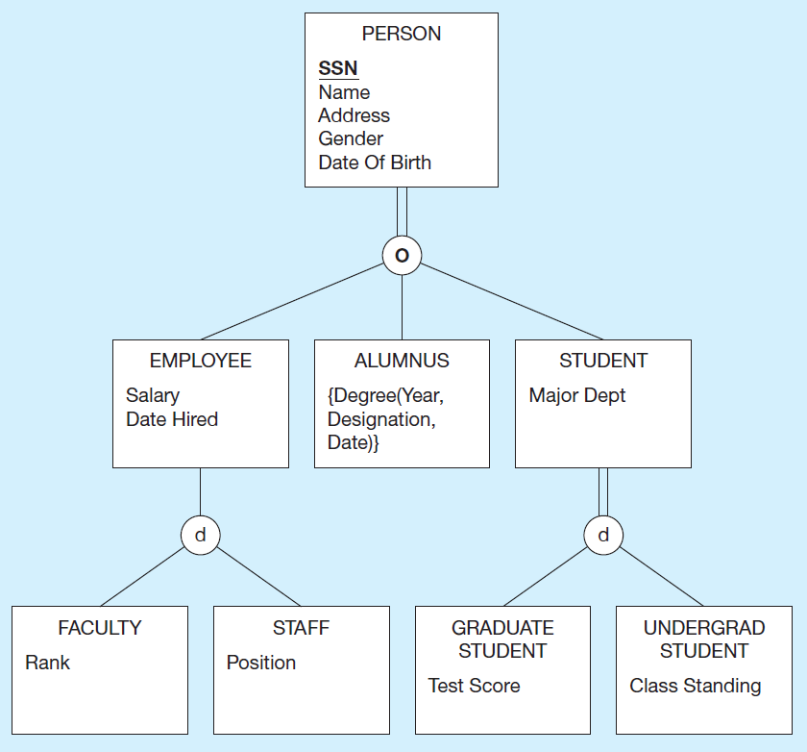
Figure 3-10 Example of Supertype/Subtype Hierarchy
Notes:
Supertype/subtype hierarchies can be as deep as we want them to be. Here we see that faculty is a type of employee which is a type of person.
Question: Note here that a person must be either an employee, alumnus, or student. Is it possible for a person to be both an employee and a student? Why or why not?
Answer: Yes, because of the overlap rule.
Question: Can you envision what the Person’s subtype discriminator would be?
Answer: It has to be a composite attribute.
Question: Is it possible for an employee to be something other than Faculty or Staff? Why or why not?
Answer: Yes, because of partial specialization.
Question: Is it possible for an employee to be both faculty and staff?
Answer: No, because of disjoint (not overlap) under Employee.
Question: Is it possible for a staff member to also be a graduate student?
Answer: Yes, because of the overlap rule under Person.
Question: Is it possible for someone to have more than one degree from this university?
Answer: Yes, because Degree is a multivalued attribute.

Slide 25
Entity Clusters
E E R diagrams are difficult to read when there are too many entities and relationships.
Solution: Group entities and relationships into entity clusters.
Entity cluster: Set of one or more entity types and associated relationships grouped into a single abstract entity type

Slide 26
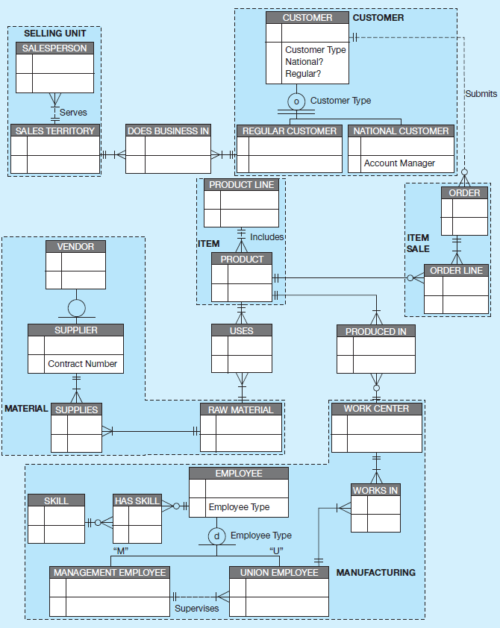
Figure 3-13 Entity Clustering for Pine Valley Furniture Company (1 of 2)
a) Possible entity clusters (using Microsoft Visio)
Related groups of entities could become clusters
Notes:
Here we see 22 entities. That’s a lot, and can be difficult to read and make sense of at an aggregate, summary level.

Slide 27
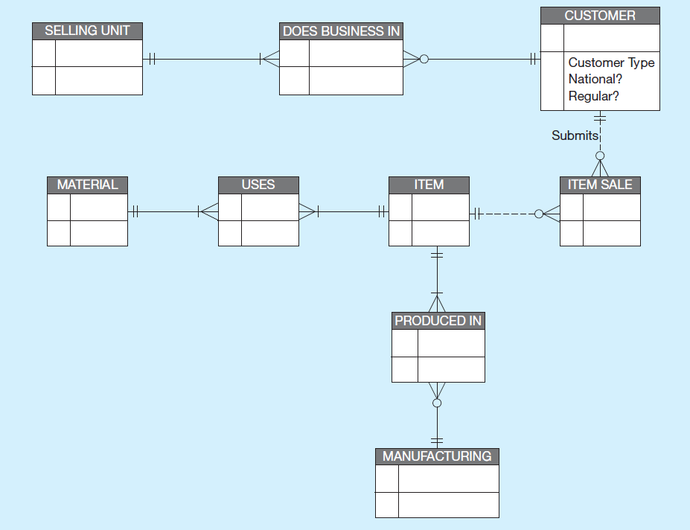
Figure 3-13 Entity Clustering for Pine Valley Furniture Company (2 of 2)
b) E E R diagram for entity clusters (using Microsoft Visio)
More readable, isn’t it?
Notes:
Here, we clustered these 22 entities into eight clusters. The relationships between clusters occur if there are relationships between entities within the individual clusters. For example, since there is a 1:N relationship between the Customer entity and the Order entity, this implies a 1:N relationship between the Customer cluster and the Item Sale cluster.
Note that the associative entities often stand apart from the clusters and provide linkages between them.

Slide 28
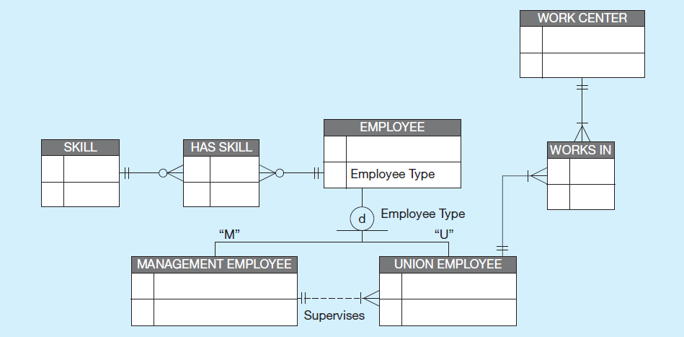
Figure 3-14 Entity Clustering for Pine Valley Furniture Company
Detail for a single cluster
Notes:
You can imagine the entity cluster diagram to be a “bird’s eye view” model. The modeler can then “drill down” to see detailed views of individual clusters.

Slide 29
Packaged Data Models
Predefined data models
Could be universal or industry-specific
Universal data model = a generic or template data model that can be reused as a starting point for a data modeling project (also called a “pattern”)

Slide 30
Advantages of Packaged Data Models (1 of 2)
Use proven model components
Save time and cost
Less likelihood of data model errors
Easier to evolve and modify over time
Aid in requirements determination
Easier to read
Supertype/subtype hierarchies promote reuse

Slide 31
Advantages of Packaged Data Models (2 of 2)
Many-to-many relationships enhance model flexibility
Vendor-supplied data model fosters integration with vendor’s applications
Universal models support interorganizational systems

Slide 32
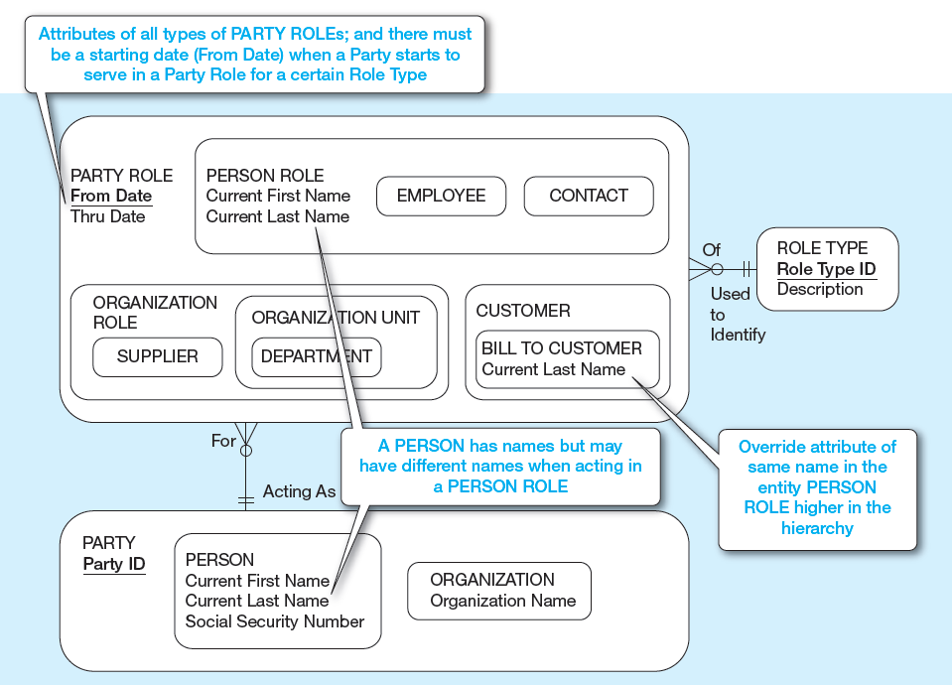
Figure 3-15 PARTY, PARTY ROLE, and ROLE TYPE in a Universal Data Model (1 of 2)
a) Basic PARTY universal data model
Packaged data models are generic models that can be customized for a particular organization’s business rules.
Notes:
You can imagine the entity cluster diagram to be a “bird’s eye view” model. The modeler can then “drill down” to see detailed views of individual clusters.

Slide 33
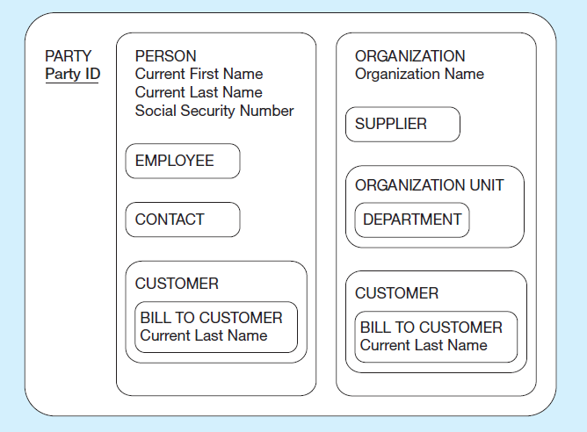
Figure 3-15 PARTY, PARTY ROLE, and ROLE TYPE in a Universal Data Model (2 of 2)
b) PARTY supertype/subtype hierarchy
Notes:
Here we see an alternative notation for supertype/subtype representations. E-R and EER models have various ways they can be represented in diagrams. But conceptually they are all pretty similar.

Slide 34

Copyright

